Slide 1
Project Recommendation
Team 9 (The Profit)
Agatha Putri, Antonius Raharja, Esther Pan, Sumeet Duddagi, Yongjun Kim, Xiao Xiao

Slide 2
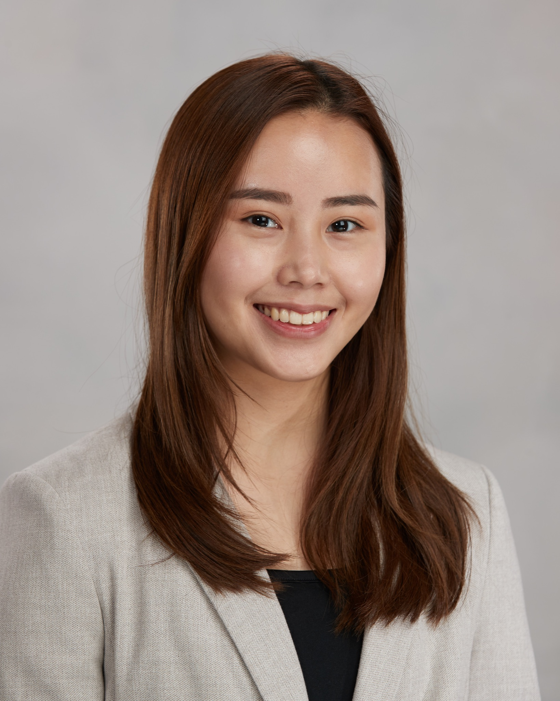





The Team
Agatha Putri
Antonius Raharja
Esther Pan
Sumeet Duddagi
Yongjun Kim
Xiao Xiao

Slide 3
Presentation Outline
Recap of project problem, data, models, and analyses
Insights developed from the analyses
Recommendations and managerial implications

Slide 4
Project Overview
Problem Statement
Project Objective
Why Marketing Analytics Important?
Since the telephonic marketing campaigns require huge investment, in order to maximize its profit, the bank needs to target the right customers, who are most likely to subscribe to term deposits.
Based on the customers’ demographics, geographics, and psychographics information, including their age, type of jobs, marital status, education, credit default status, loans, we want to find out beforehand which groups of customers are more likely to subscribe term deposits from telephonic marketing campaigns, so that the bank can maximize its profit from its marketing campaigns.
Needs to determine the right customers by doing segmentation, targeting and positioning in doing promotion.
Notes:
Now, the question is, why marketing analytics important in this project?
In our case, our focus is customers; and our customers is the people who is willing to subscribe the term deposits from the telephone marketing campaign.
And to reach our goal, we need to implement marketing strategy.
- First, Segmentation: we need to classify people whose needs within-group are similar & whose needs between groups are different. In our case, we use demographic and psychographic information.
The Demographic information includes age, type of jobs, marital status, and education.
The Psychographic information includes credit default status, housing loan, and personal loan.
- Second, Targeting: we need to identify which group of people who can be reached profitably.
We need to Identify the customers who are most likely to convert /subscribe the term deposits, even before doing the marketing campaign.
- Third, Positioning: in this case, we use a focus marketing program of telephonic marketing campaigns because it is proven as the most effective way to reach people
For the tactics, this case uses promotion. During the telephonic marketing campaign, the bankers promote the benefits of subscribe the term deposits
THEREFORE, IN ORDER TO TARGET THE RIGHT CUSTOMERS TO MAKE OUR MARKETING CAMPAIGN EFFECTIVE, WE NEED MARKETING ANALYTICS.

Slide 5
DATA
Methods Used:
K-means Clustering (Demographics)
Segment customers based on their profiles (age, jobs, marital status, education, credit default status, housing loan, personal loan)
Target the right groups of customers to contact
Forward Feature Selection
Selected 10 variables based on forward selection
Confirmed using backward selection features
Logistics Regression (Variables based on Forward Selection)
Predict if the prospect will subscribe to a term deposit product
Identify the important attributes involving customers’ decision-making.
Data Source:
Open datasource Kaggle
41,188 rows and 21 columns in the dataset.
Marketing campaigns of a Portuguese Banking Institution

Slide 6
K-Means Clustering Analysis Findings
Cluster Profile | Age | Job | Marital Status | Education | Credit in Default | Response rate (Total level: 11.27%)
40s, Married, secondary educated, middle aged, blue-collar (7,160) | 41 | Blue-collar (66.24%) | Married (84.48%) | Basic.9y (73.23%) basic.6y (26.78%) | No (67.74%) | 7.00%
Young, married, post secondary educated (11,835) | 35 | Admin (33.24%) Technician (21.04%) | Married (85.74%) | University (40.60%) | No (86.25%) | 9.98%
Young, single, post secondary educated (10,314) | 33 | Admin (37.42%) Technician (22.16%) | Single (99.29%) | University (41.89%) | No (88.38%) | 12.70%
Senior, retired, married (1,711) | 62 | Retired (99.94%) | Married (74.93%) Divorced (20.57%) | Basic.4y (41.26%) | No (77.44%) | 25.72%
Student, single (913) | 26 | Student (96.60%) | Single (93.76%) | High school (58.16%) | No (87.40%) | 31.00%
Senior, married, working (9,255) | 50 | Admin (23.42%) Blue-collar (18.08%) | Married (79.99%) | University (32.80%) High school (25.50%) | No (67.97%) | 10.00%
Notes:
Response rate: the proportion of people within the group buying the product after contact.
Response rate = sum(y) / number of people in the group; y is dependent variable, y=1 means the client decided to buy product after contact

Slide 7
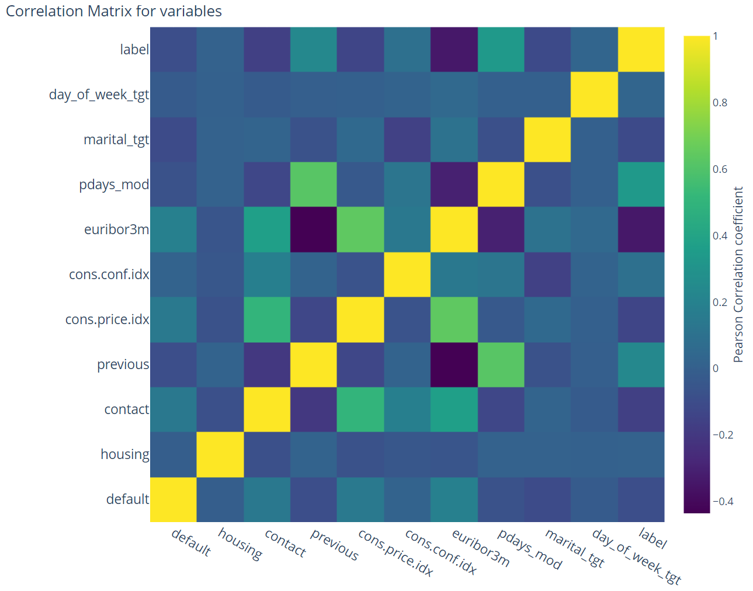
Logistics Regression Analysis on Targeting Groups
 | VIF
default | 1.064723
housing | 1.009303
contact | 1.502453
previous | 1.867287
cons.price.idx | 2.424126
cons.conf.idx | 1.258248
euribor3m | 2.496997
pdays_mod | 1.717347
marital_tgt | 1.067002
days_of_week_tgt | 1.006225
Pick 10 features using Forward Selection
Correlation Matrix and VIF show no multicollinearity
(Rule of thumb is less than 10)
Notes:
https://online.stat.psu.edu/stat462/node/180/#:~:text=The%20general%20rule%20of%20thumb,of%20serious%20multicollinearity%20requiring%20correction.

Slide 8
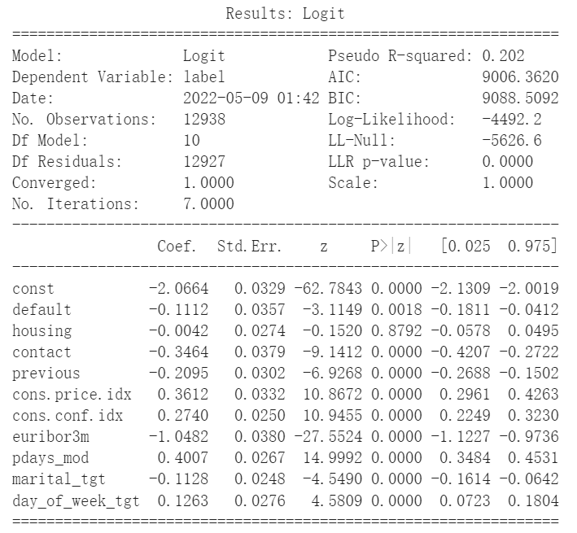
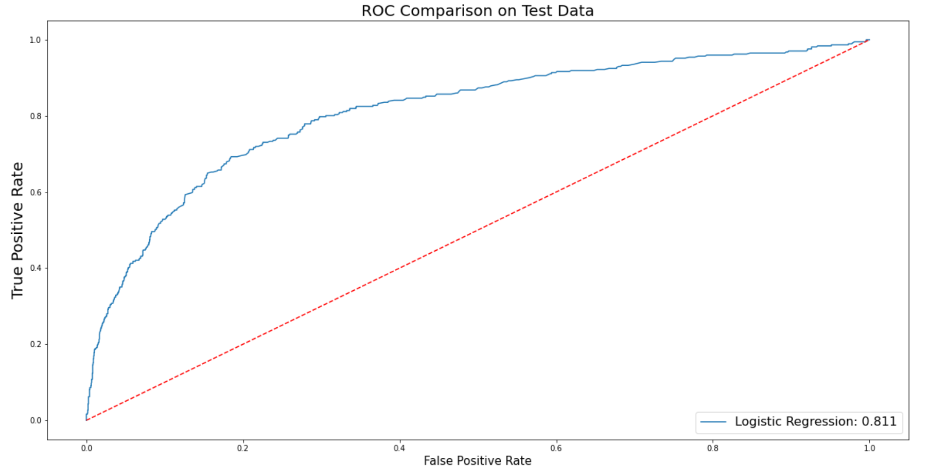
Logistics Regression Analysis on Targeting Groups
9 variables are statistically significant
euribor3m has the most significant effect
Housing effect has the most insignificant effect
Accuracy is 85.7%, AUC is 81.1%
Pseudo R-squared is 0.202
(Rule of thumb ranges from 0.2 to 0.4)
Notes:
https://stats.stackexchange.com/questions/82105/mcfaddens-pseudo-r2-interpretation#:~:text=A%20rule%20of%20thumb%20that,isn't%20particularly%20strong%20either.

Slide 9
Understanding the Results

Slide 10
Analysis Findings
Target groups
College Students (31.00%)
Senior who are retired (25.72%)
Youngsters who are single and working (12.70%)
Cluster Profile | Age | Job | Marital Status | Education | Credit in Default | Response rate (Total level: 11.27%)
Young, single, post secondary educated (10,314) | 33 | Admin (37.42%) Technician (22.16%) | Single (99.29%) | University (41.89%) | No (88.38%) | 12.70%
Senior, retired, married (1,711) | 62 | Retired (99.94%) | Married (74.93%) Divorced (20.57%) | Basic.4y (41.26%) | No (77.44%) | 25.72%
Student, single (913) | 26 | Student (96.60%) | Single (93.76%) | High school (58.16%) | No (87.40%) | 31.00%
Notes:
Finally we could obtain three groups which had highest response rates. Response rate is the proportion of people within the group buying the product after contact.
First is students who are majorly single with the highest response rate of 31%
Secondly senior people who are married and retired with the second highest response rate of 25.72%
Thirdly relatively young people, who are single and well educated with third highest response rate of 12.70%
Response rate = sum(y) / number of people in the group; y is dependent variable, y=1 means the client decided to buy product after contact

Slide 11
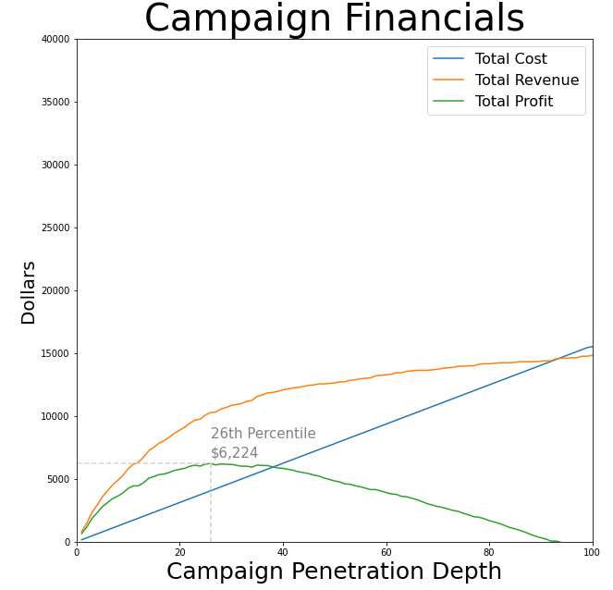
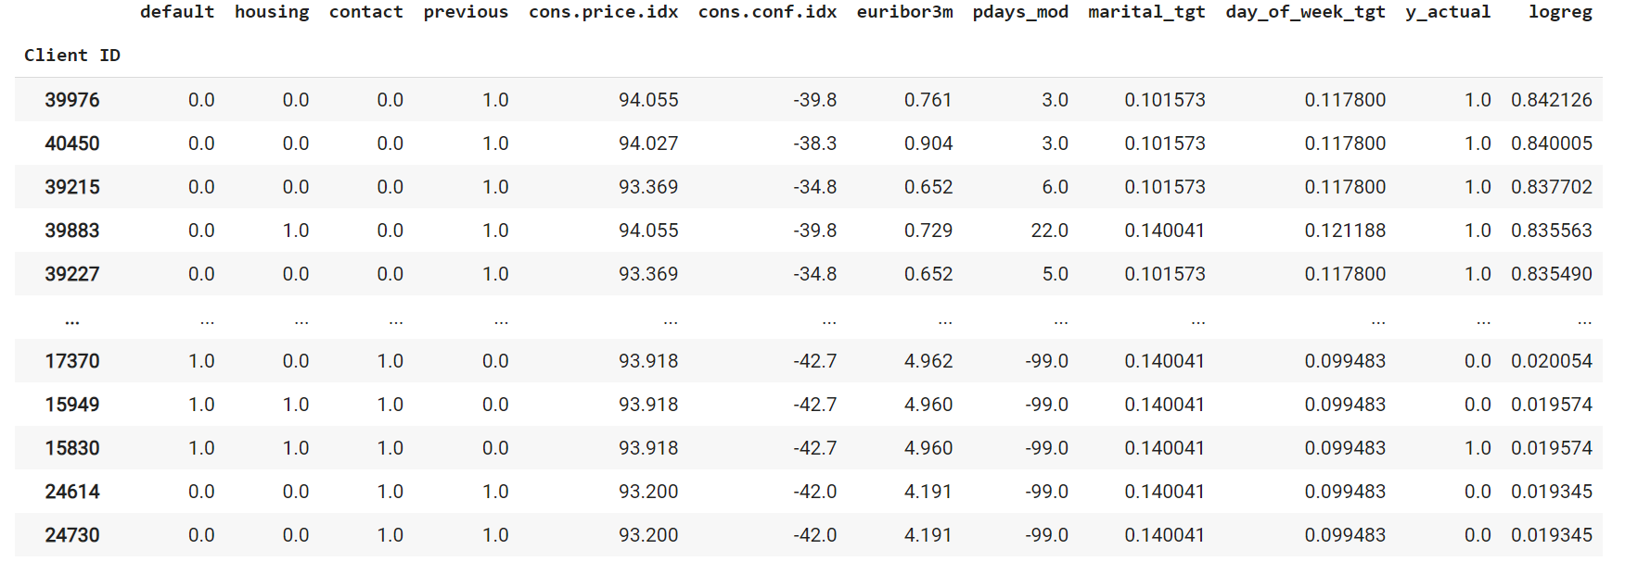
Analysis Findings
Assumed cost of $6 per contact and revenue of $40 if we convert the customers for a term deposit. (Threshold=6/40=15%)
Expected profit of a client = 40 * predicted probability - 6
Contact clients with highest probability first, until expect profit is less than 0
By further analyzing our three target groups, we found out that we can achieve maximum profit by only contacting the first 26% of customers.
Notes:
A phone banker's hourly wage is 18 dollars on average, and we suppose that each banker spends 20 minutes with each customer, thus leading the cost to dollars per contact. Furthermore, the most frequent term deposit minimum is $1,000, with banks typically earning 4 to 5% on each dollar deposited. As a result, we choose a revenue of $40.

Slide 12
Insights
Clustering
Highest response: College students
Second highest response: Group of people who are senior and retired.
Least response: 40s, Married, well educated group having blue-collar jobs.
Logistic Regression
Our Logistic Regression algorithm predicts the probability of a particular customer purchasing a term deposit.
9/10 variables are found statistically significant affecting whether to purchase term deposit or not
Achieved model accuracy of 85.7% or classification error 14.3%
As we contact more clients, the company's net profit rises; nevertheless, there is a sweet spot beyond which profit falls (as costs rise, but revenue remains constant).
By this method, the company will achieve maximum profit when they contact just 26% of our top three target groups

Slide 13
Recommendations
Better services provision
First, reach out to the married retired elder or young college student customers as our primary target. If we have greater resources, we could target the young unmarried post-secondary educated group.
More appropriate models
The results can be discussed with the bank officials to decide the cutoff for probability of conversion, and logistics regression findings can be used for specific targeting.
Smarter marketing design
More accurate information will be presented to the bank for improving the subscriptions, such as re-evaluate the content and design of its current campaign.

Slide 14
Implications
Time Effective
Not waste time on doing campaigns for customers who are not likely to subscribe for the term deposits.
Optimal Profit
Get higher response rates, which brings higher net profit.
Find the sweet spot beyond which the profit falls.
Continuous Improvement
By doing marketing analytics, the bank can always generate data and get the latest trend.
Can keep changing marketing strategy based on the marketing analysis results.
Notes:
Our analysis insights and recommendations will bring the bank at least 3 positive implications.
Firstly, By targeting and reaching out to the right customers, the bank does not need to waste time on doing campaigns for customers who are not likely to subscribe for the term deposits. The bank can invest the time and put more effort more into how to turn the target customers to subscribe for the term deposits, such as designing a better marketing campaigns.
Secondly, telephonic marketing campaigns incur a quite high of marketing cost. By targeting the right customers, with a well-designed marketing campaigns, the bank can get higher response rates. So, the bank can generate more revenue, and can bring higher net profit. Furthermore, based on our analysis, we can also determine the sweet spot beyond which the profit falls. So, the bank will not undergone a situation where the revenue is constant while the marketing cost keeps rising.
Lastly, By doing marketing analytics, the bank can always generate data and get the latest trend of the telephonic marketing campaign results. So, the bank can keep analyzing and improving its marketing strategy based on the marketing analysis results.

Slide 15
Q & A

Slide 16
Citations & References
Adsit, D. J., Bobrow, W. S., Hegel, P. S., Fitzpatrick, B. G., & Kaiser, R. B. (2018). The Return on Investment of Rank and Yank in a Simulated Call-Center Environment. Educational Publishing Foundation, 113-128.
Byrne, J. A. (2017, 09 02). Big banks make a lot of money off your deposits: report. Retrieved from New York Post: https://nypost.com/2017/09/02/big-banks-make-a-lot-of-money-off-your-deposits-report/
Chris, A. (2014, 05 21). McFadden's Pseudo-𝑅2 R 2 Interpretation. Retrieved from Stack Exchange: https://stats.stackexchange.com/questions/82105/mcfaddens-pseudo-r2-interpretation#:~:text=A%20rule%20of%20thumb%20that,isn't%20particularly%20strong%20either
Information Gatekeepers, Inc. (2002). India gets $232 million investment in call center. Asia Pacific Telecom, Vol.6 (10), p.6.
Kaggle. (2022, April 17). Bank Marketing Data Set. Retrieved from Kaggle: https://www.kaggle.com/datasets/alexkataev/bank-marketing-data-set?select=bank-additional-full.csv
Marketing Weekly News. (2019, June 08). Patent Issued for Telephone Marketing And Message System And Method. Marketing Weekly News, p. 370.
Mushafiq, M., & Sehar, T. (2021, January 01). Reality of short-term causality of Islamic and conventional banking term deposit rates in Pakistan. Asian Journal of Economics and Banking (AJEB), pp. 66-78.
Penn State Eberly College of Science. (2018). 10.7 - Detecting Multicollinearity Using Variance Inflation Factors. Retrieved from Penn State Eberly College of Science: https://online.stat.psu.edu/stat462/node/180/#:~:text=The%20general%20rule%20of%20thumb,of%20serious%20multicollinearity%20requiring%20correction

Slide 17
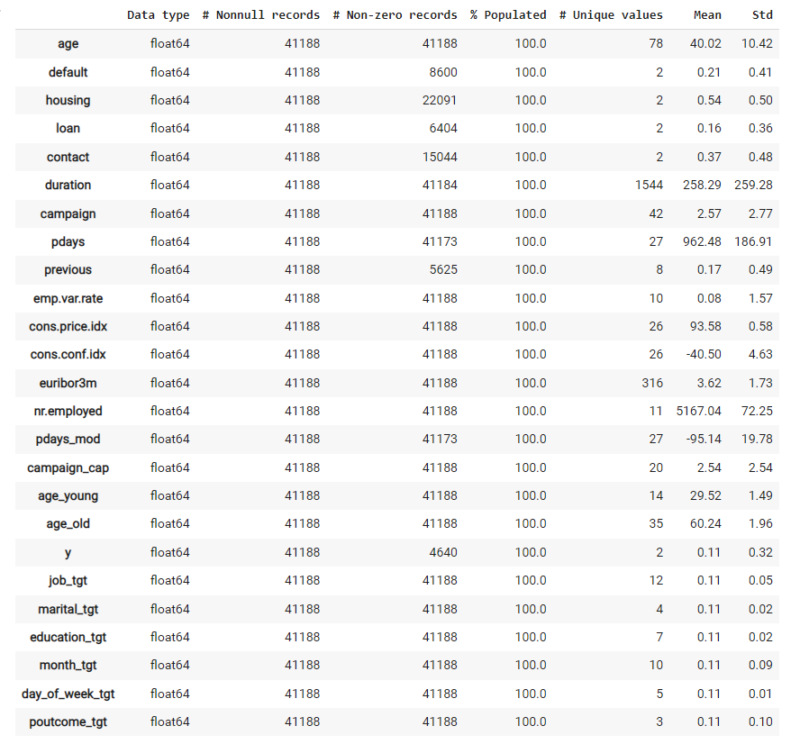
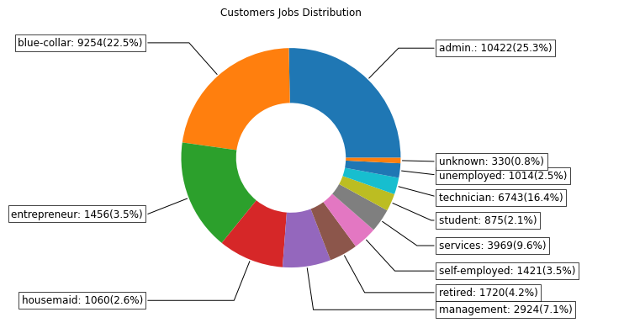
Technical Appendices
Example of one-hot encoding for binary feature
Summary of dataset after pre-processing raw data
First, we read the raw from csv file and performed exploratory data analysis and imputation
Next, we performed one-hot encoding and target encoding for the categorical variables
Example of exploratory data analysis(EDA)

Slide 18
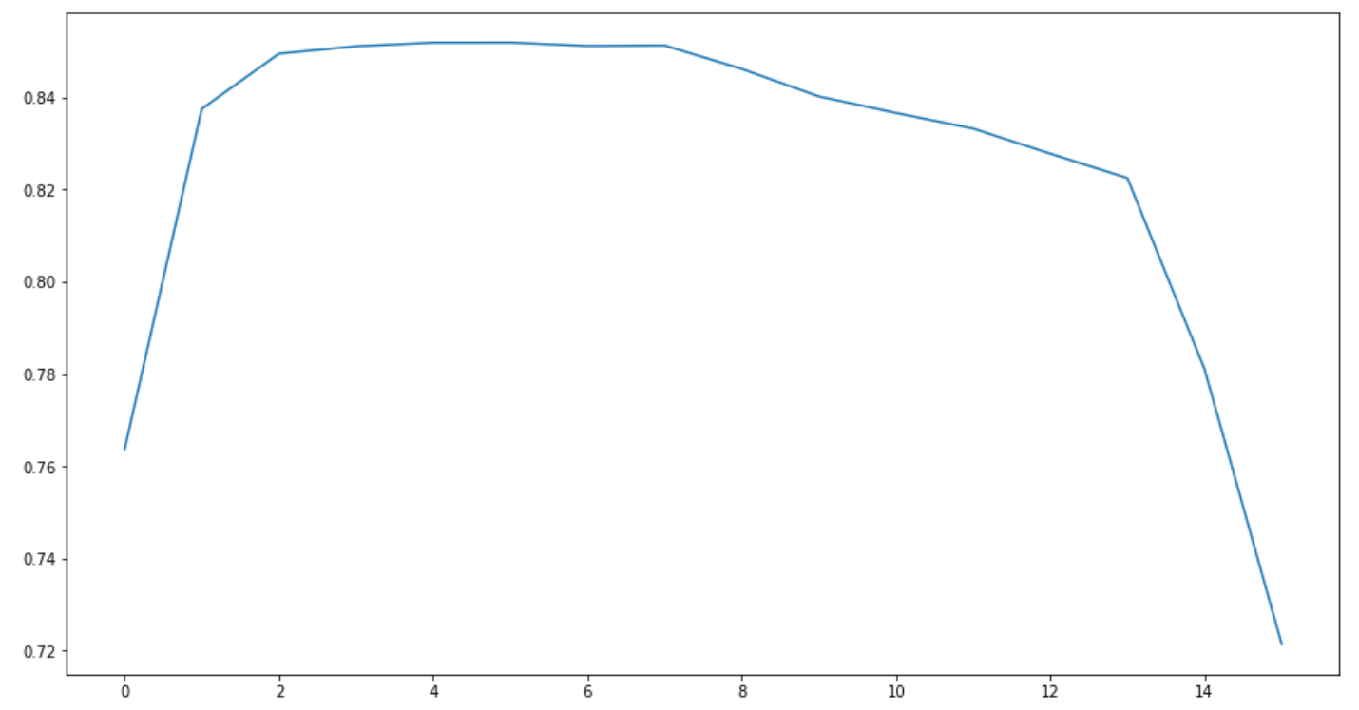
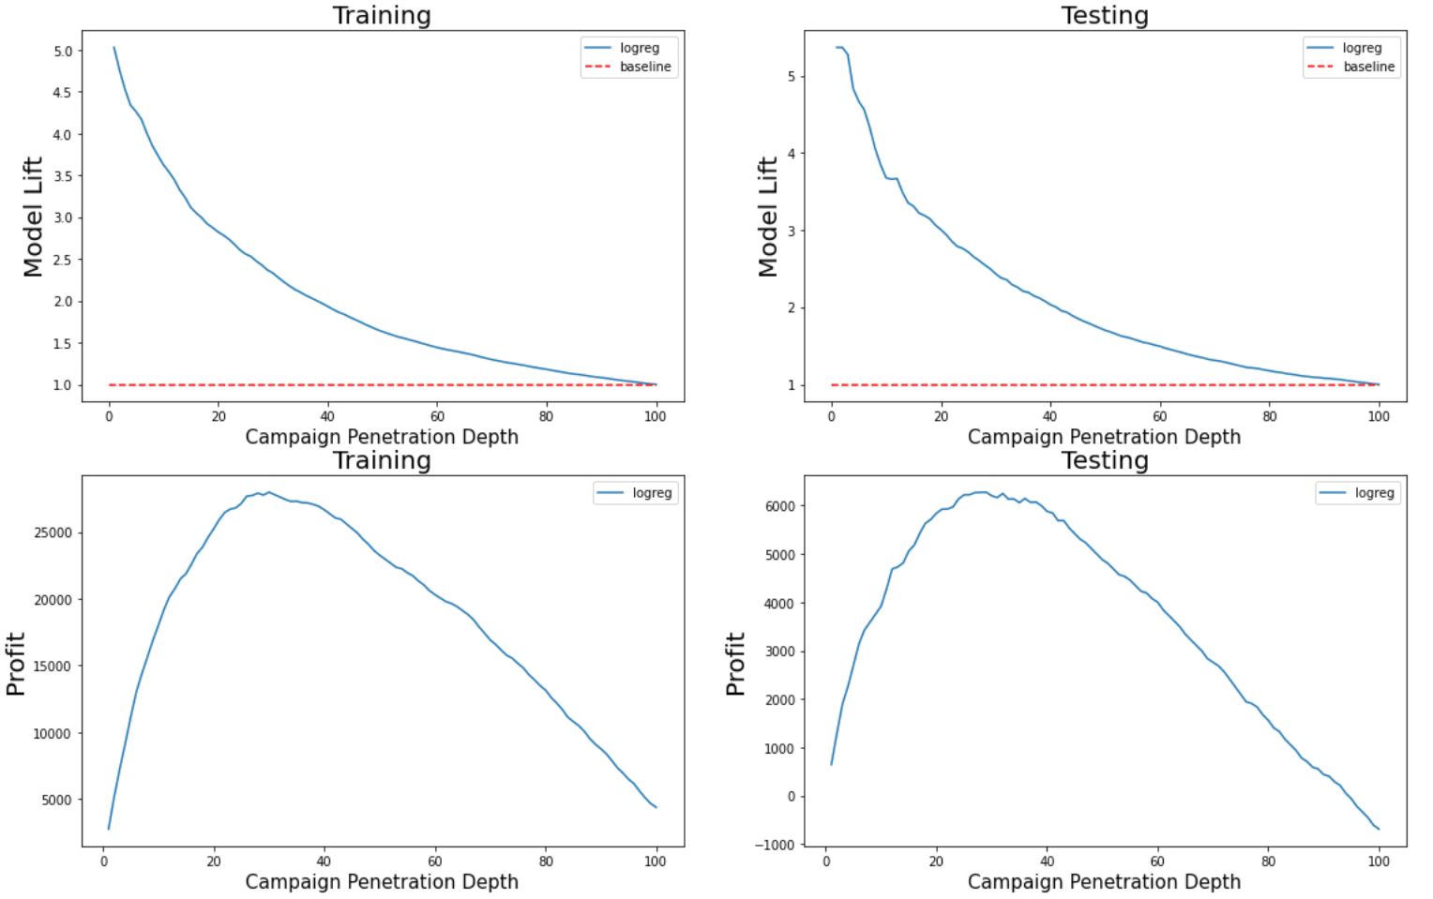
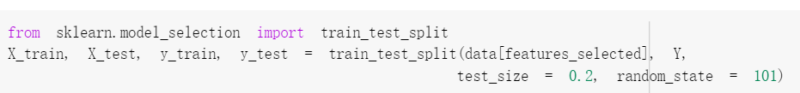
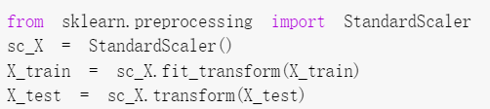
Technical Appendices
Result of Forward Selection
Then, we performed kmeans using demographic data, developed customer profiles and selected our targeting groups (as shown in the slides above)
After kmeans, we performed Forward Feature Selection and picked 10 features. We standardized the features and split into training and testing set, then fitted logistic regression to targeting groups using Sklearn
Prediction performance on training and testing dataset
Train test split
Standardization

